Slide 1

Big Data Analytics
CCNLP Mini Project Review
Group 17
04/02/2021
‹#›

Slide 2
Problem Statement and Group Details
“Conversational Chatbot as an Online Librarian”
Members:
Atharva Belamkar
Shambhavi Sinha
Akhil Bannur
Saurav Suresh
Faculty:
Prof. Preeti Kale – Internal Guide

Slide 3
Introduction
The book bot is a Telegram bot for answering book-related questions.
Users are provided an intuitive interface that allows them to easily access information about books, very similar to asking a bookstore clerk or a librarian.
The bot relies on the APIs of Google Books to extract structured information about books.
Using the chatbot is easy, as there are no specific keywords to memorize.
Users can simply ask a question in the same way they would also ask a book clerk.
This allows for greater flexibility, but also places higher requirements on the natural language understanding component of the system: It needs to be able to deal with certain semantic properties of natural language, in order for communication to be successful.

Slide 4
What are Chatbots
In place of direct communication with a live human agent, a chatbot or chatterbot is a software programme that conducts an online chat discussion using text or text-to-speech.
Chatbot systems are often designed to accurately replicate the way a person would act as a conversational partner, although many in production are still unable to speak adequately, and none of them can pass the traditional Turing test.
Chatbots are used in dialog systems for various purposes including customer service, request routing, or information gathering.
While some chatbot applications use extensive word-classification processes, natural language processors, and sophisticated AI, others simply scan for general keywords and generate responses using common phrases obtained from an associated library or database.

Slide 5
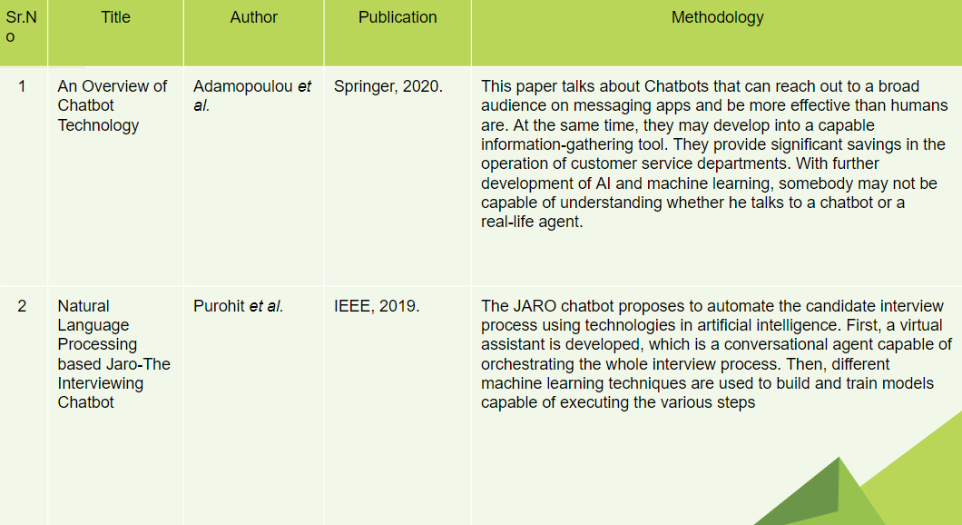
Literature Survey

Slide 6
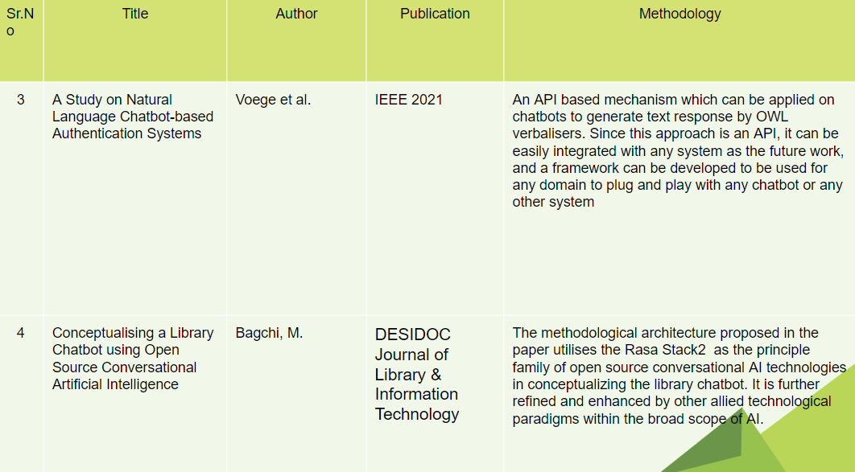
Literature Survey

Slide 7
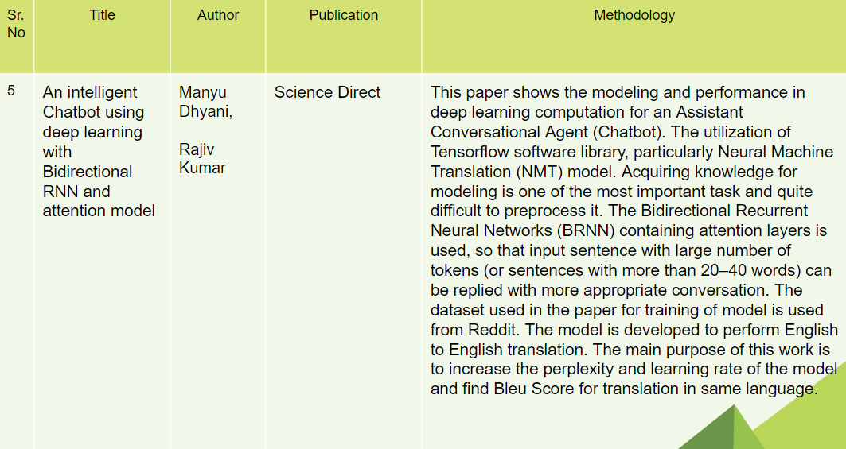
Literature Survey

Slide 8
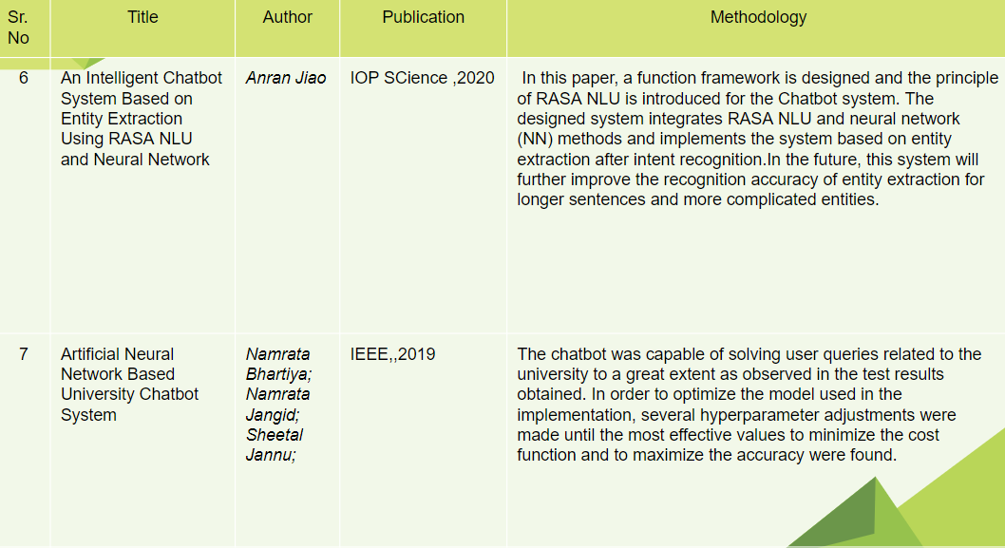
Literature Survey

Slide 9
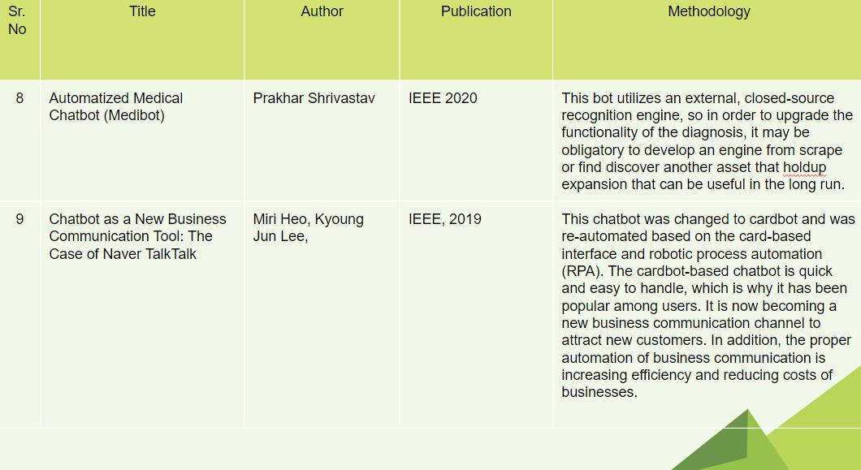
Literature Survey

Slide 10
Project Methodology
For this project, we will need to install the following dependencies/ libraries and APIs.
Telebot
NLTK
OS
sys
Telegram API
Google Books API

Slide 11
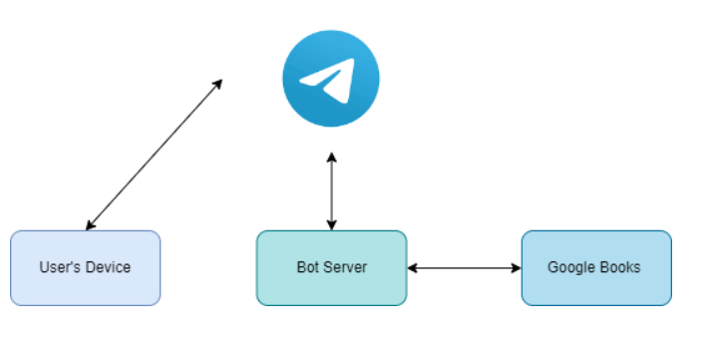
System Block Diagram

Slide 12
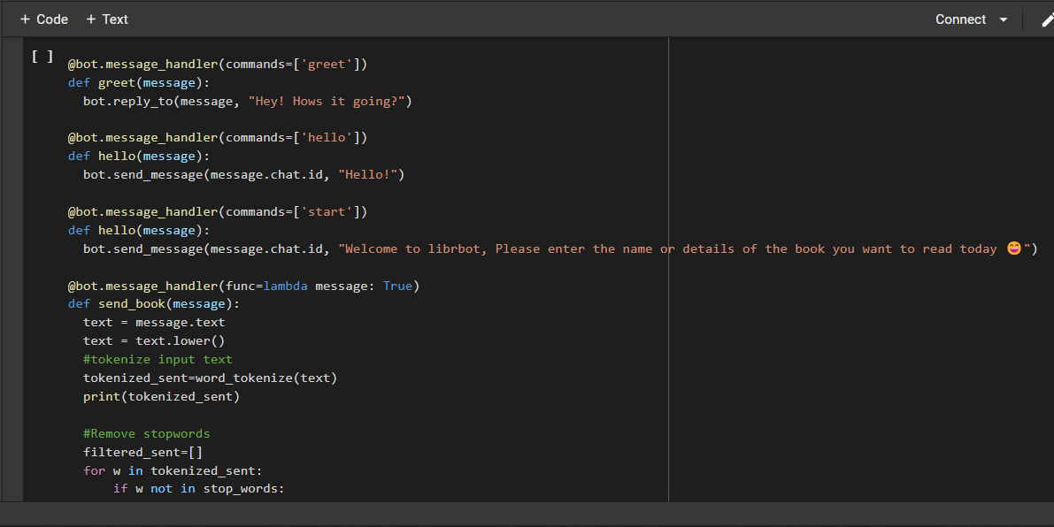
Project Screenshots

Slide 13
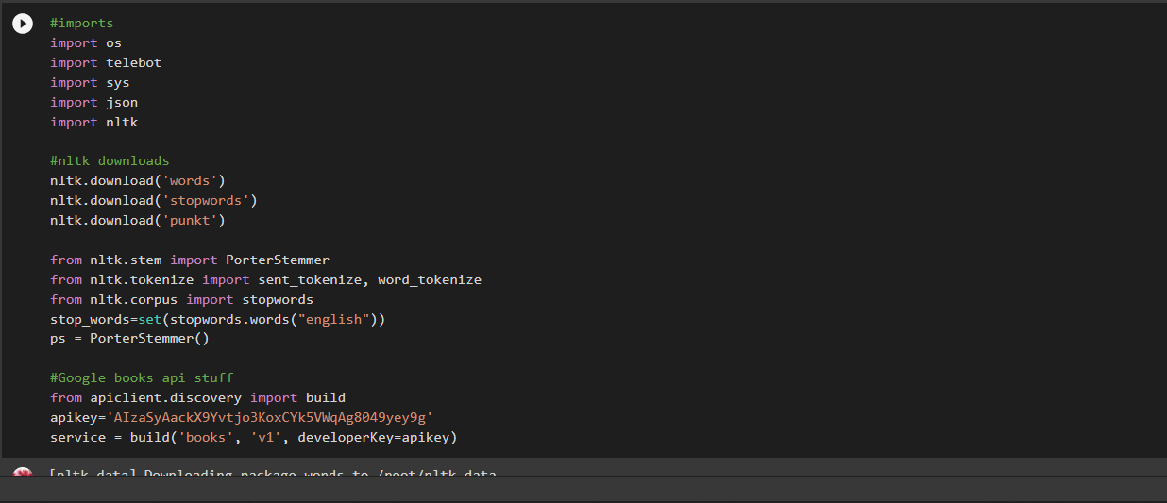
Project Screenshots

Slide 14
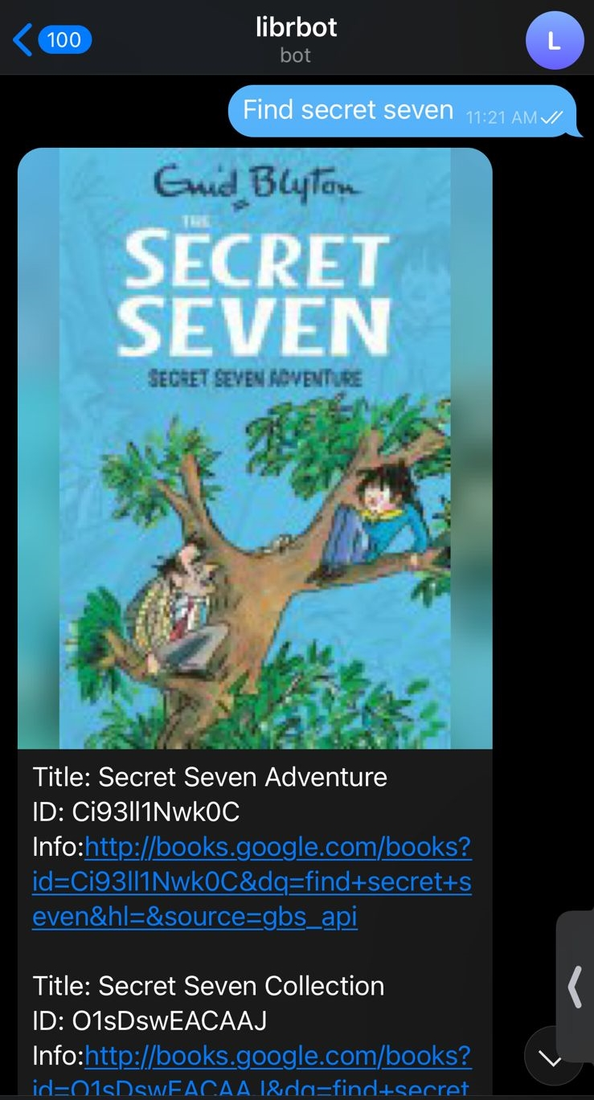
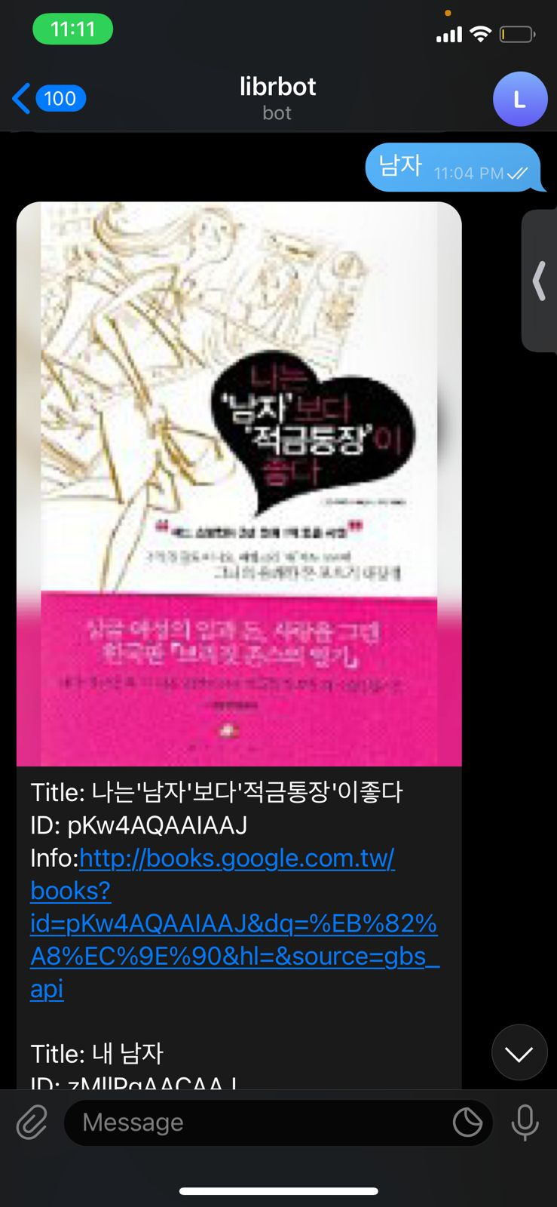
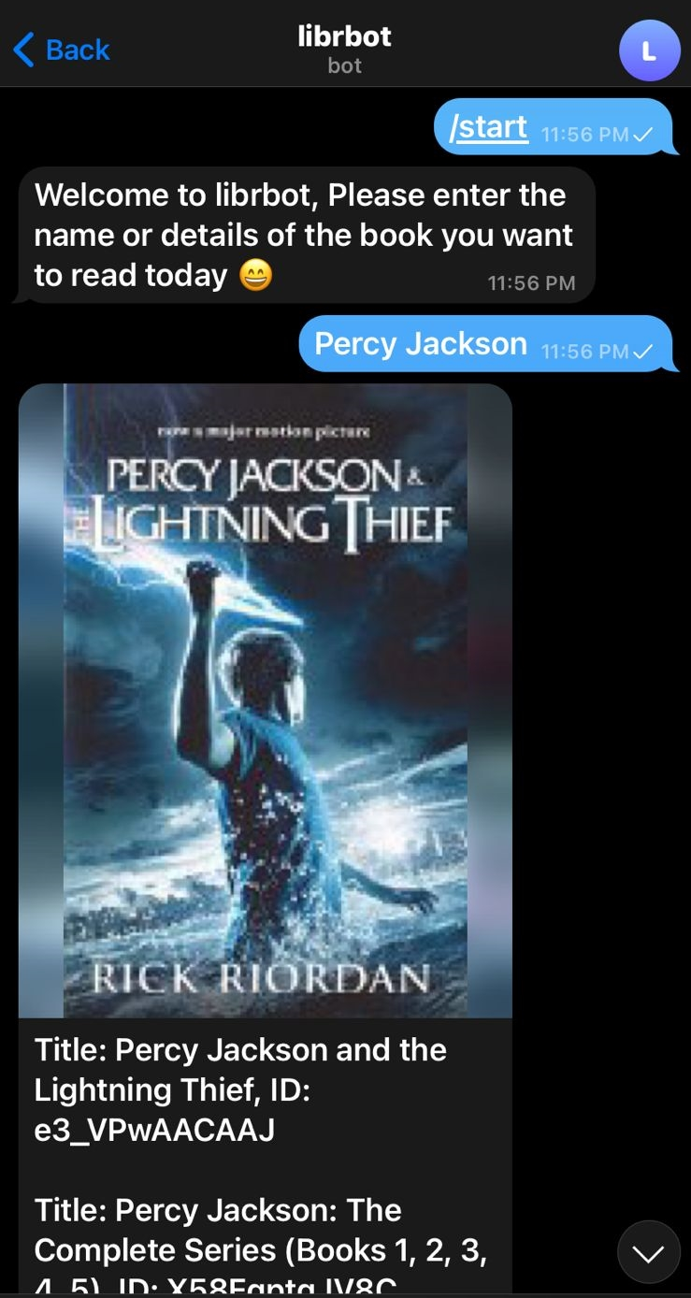
Results

Slide 15
Conclusion
We constructed a simple Telegram chatbot in this mini project that returns the library equivalent name of the books when the author's name is mentioned, and vice versa.
With the aid of the Google Books API, it can also list all of the books in a specific series, and it can be used smoothly with Telegram thanks to the Telegram API.

Slide 16
References
Allison, D. (2012), "Chatbots in the library: is it time?", Library Hi Tech, Vol. 30 No. 1, pp. 95-107.
J. Purohit, A. Bagwe, R. Mehta, O. Mangaonkar and E. George, "Natural Language Processing based Jaro-The Interviewing Chatbot," 2019 3rd International Conference on Computing Methodologies and Communication (ICCMC), 2019, pp. 134-136, doi: 10.1109/ICCMC.2019.8819708.
P. Voege and A. Ouda, "A Study on Natural Language Chatbot-based Authentication Systems," 2021 International Symposium on Networks, Computers and Communications (ISNCC), 2021, pp. 1-4, doi: 10.1109/ISNCC52172.2021.9615767.
Bagchi, Mayukh. (2020). Conceptualizing a Library Chatbot using Open Source Conversational Artificial Intelligence. DESIDOC Journal of Library & Information Technology. 40. 329-333. 10.14429/djlit.40.06.15611.
Matteo Carisi, Andrea Albarelli, and Flaminia L. Luccio. 2019. Design and implementation of an airport chatbot. In <i>Proceedings of the 5th EAI International Conference on Smart Objects and Technologies for Social Good</i> (<i>GoodTechs '19</i>). Association for Computing Machinery, New York, NY, USA, 49–54. DOI:https://doi.org/10.1145/3342428.3342664
An Intelligent Chatbot System Based on Entity Extraction Using RASA NLU and Neural Network Anran Jiao 2020 J. Phys.: Conf. Ser. 1487 012014
Heo, Miri & Lee, Kyoung. (2018). Chatbot as a New Business Communication Tool: The Case of Naver TalkTalk. Business Communication Research and Practice. 1. 41-45. 10.22682/bcrp.2018.1.1.41.
P. Srivastava and N. Singh, "Automatized Medical Chatbot (Medibot)," 2020 International Conference on Power Electronics & IoT Applications in Renewable Energy and its Control (PARC), 2020, pp. 351-354, doi: 10.1109/PARC49193.2020.236624.

